Slide 1
Procurement Basics
Leslie Hoff, Controller
Prepared June 2025

Slide 2
Agenda
General Accounting
Accounting Equation
FOAP
Accounting in Higher Ed
Business Office Forms
Business Office General Guidance
Business Office Staff

Slide 3
General Accounting
Assets = Liabilities + Equity
Assets – Cash, Equipment, Accounts Receivable
Liabilities – Accounts Payable, Notes Payable, Accrued Expenses
Equity – Fund Balance
Equity = Income – Expense + Net Position (Fund Balance)
Income – Tuition, Grants, State Appropriations
****Expense – Supplies, Contracted Services, Utilities, Travel****

Slide 4
Accounting in Higher Ed. (FOAP)
Fund = Self Balancing Set of Accounts
Organization = Department – Assets and Liabilities do not have Organizations
Account = Natural Expense Allocation (Electricity, Rent, Supplies, etc.)
Program = Functional Allocation (Instructional, Academic Support, Administration & General)
Revenue is always 95
Assets and Liabilities do not have Program Codes
Organization and Program are often the same pairing
Activity Codes are used for reporting purposes on projects, they are never required

Slide 5
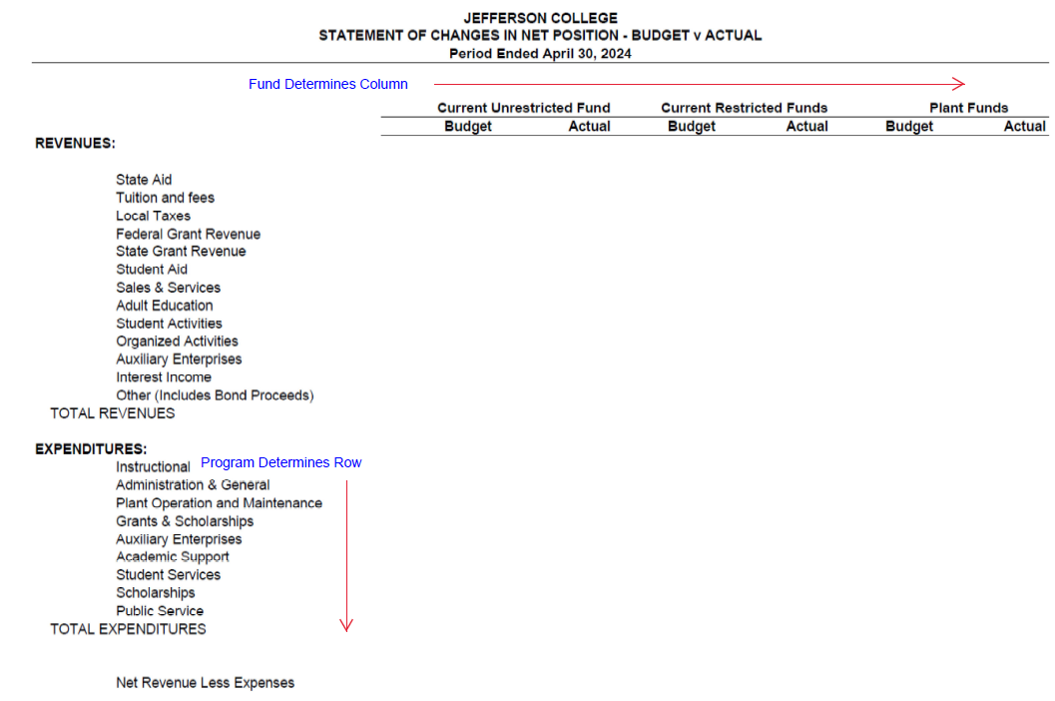
FOAP – Fund, Org, Account, Program

Slide 6
Business Office Forms
General Requisition -
Orders for Payment -
Travel Expense Voucher -
Procurement Card Log -
FOAP Finder Tool -
Business Office Forms

Slide 7
Business Office General Guidance
General Requisition = Purchase Order
Orders for Payment = Invoice
Include Vendor # when submitting GR or OFP
New Vendors must provide a completed W-9 form, might also need Certificate of Insurance
All invoices can and should be emailed to ap@jeffco.edu
Process invoices as quickly as possible
Use a Purchase Order when you can

Slide 8
Business Office General Guidance
The College’s payment terms are Net 30 Days.
The College is subject to public records requests and can not agree to keep vendor information confidential.
The College’s accounts are tax free therefore it is not allowable for employee to make personal purchases on the College’s accounts.
Include all relevant documents
Contracts (signed)
Proposals
Quotes
Invoices (Statements, Packing Slips and Bills of Lading are not acceptable)

Slide 9
Business Office General Guidance
General Requisitions
Include V#, vendor email address and contact name
Include W9
Include quote number if applicable
General Requisition becoming Purchase Order
Return the signed Receiving copy of the Purchase Order with the Final Invoice
Include Purchase Order Number on the Invoice
Business Office takes over from here

Slide 10
Business Office General Guidance
Professional Development
Travel (624011) – Lodging, Transportation, Mileage, Car Rental, Tolls, Parking and Meals
Other (624012) – Anything Else – Course registration, Supplies, Materials, Fees, Consultants
General Travel
Travel – General Business (6275) - Lodging, Transportation, Mileage, Car Rental, Tolls, Parking and Meals Not Related to Professional Development
Student Engagement (6249) – Expenses incurred for Students for Non-Instructional Development Activities. Can be Travel, Meals, Swag

Slide 11
Business Office General Guidance
Contracted Services vs Instructional Service vs Service Agreements vs Software Expense
General Contractor Services (60852) – What you would think of as a Contractor; usually has a toolbox
Instructional Services (60853) – Third Party services related to providing instruction
Service Agreements (60854) – Intangible and for a period of time. Would include maintenance and service agreements on software but not access to the software itself
Software Expense (6247) (Software as a Service) – Related to Software can be a one-time purchase or a renewable subscription. It is only buying you access to the software and not additional support functions

Slide 12
Business Office General Guidance
Supplies Accounts
Instructional Supplies (62551) – Classroom/Instructional Use
Office Supplies (62552) – Staff Use in Carrying out their Jobs (Not Technology)
Maintenance Supplies (62554) – Repair and Maintenance of College Property
Athletic Supplies (62555) – Athletic Use
Computer Supplies (62556) – Staff Use in Carrying out their Jobs (Technology)
Other Supplies (62553) – Supply that doesn’t fit into any of the above categories (Police Department, Totes, Batteries, Displays, Drying Rack, Decorations . . .)

Slide 13
Business Office Staff
Megan Hunter – Assistant Controller – mhunter9@jeffco.edu – extension 3131
General Accounting Guidance
Help determining your accounting string
Something needs to be reclassified
Budget questions
Reports for Data Analysis
Crystal Rector– Accounting Manager – crector2@jeffco.edu – extension 3124
Grants and Fixed Assets
Grants
Inform when a new grant has been awarded and include relevant documentation
Inform when you have submitted a request for payment
Fixed Assets
Help determining if the purchase is a fixed asset
Inform Who, When, Where, What
Inform Sale or Scrap of an item

Slide 14
Business Office Staff
Joe Smreker-Bruce– Procurement Clerk – jsmreker@jeffco.edu & ap@jeffco.edu – extension 3506
Purchasing and Requisitions
Questions or Help with Placing Requisitions
Jared Imlay– Accounting Clerk – jimlay1@jeffco.edu & ap@jeffco.edu – extension 3129
Purchase Order Tracking
Questions or Help with Invoices and Purchase Orders
Susan McCarty – Accounts Payable Specialist – smccart4@jeffco.edu – extension 3122
Accounts Payable
Questions or Help with Procurement Card Logs, Travel Reimbursement, Tuition and Checks

Slide 15
Questions? Thank You For Being Here. We Look Forward To Working With You.

